Slide 1
AQE Final Project
Amey Pachpande Employee ID:- 201319

Slide 2
Project Topics
1. Automation using Selenium (Java)
2. Creating Docker image of a Spring boot application and deploying it in a container.

Slide 3
My work in Automation using Selenium (Java)
In this Project I have fully automated the geeksforgeeks website and performed test cases using testng.
In this project we have used the web driver to access the browsers functionality e.g. EdgeDriver ed= new EdgeDriver();
We have also used the Actions class which is used to perform complex interactions with web elements, such as mouse movements, keyboard actions, drag-and-drop operations, and more e.g.
Actions actions = new Actions(ed);
actions.moveToElement(element).perform();

Slide 4
My work in Automation using Selenium (Java)
In this project we have also used TestNG assertions and annotations e.g.
SoftAssert sa=new SoftAssert();
dr.get("https://www.geeksforgeeks.org/");
String expTitile = "GeeksforGeeks | A computer science portal for geeks";
String actTitle = dr.getTitle();
System.out.println(dr.getTitle());
sa.assertEquals(actTitle, expTitile);

Slide 5
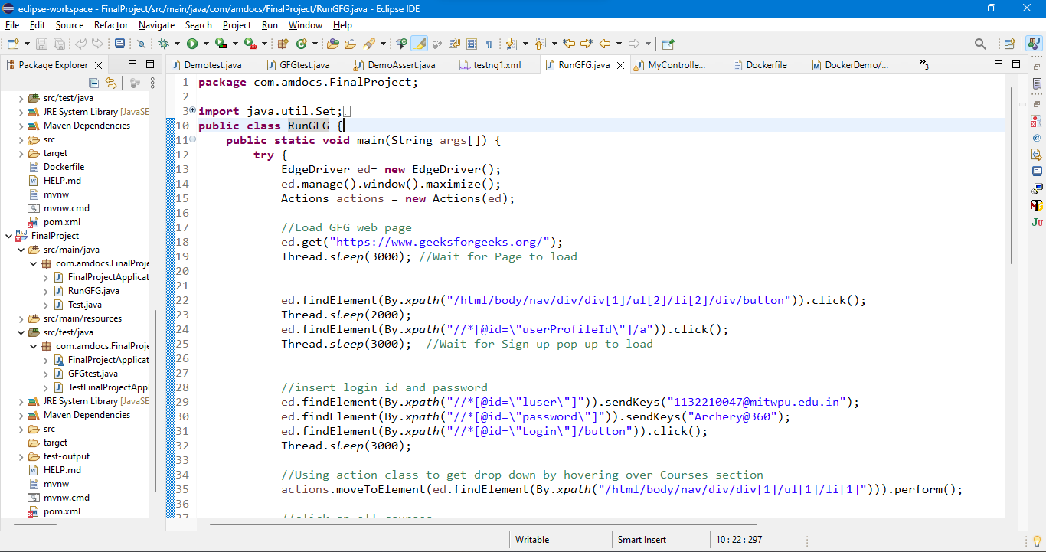
Selenium code screenshots

Slide 6
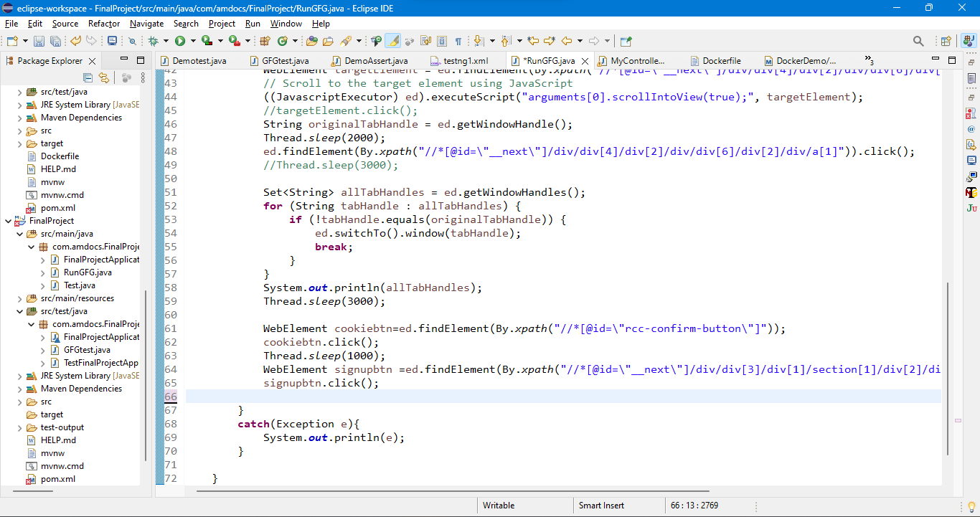
Selenium code screenshots

Slide 7
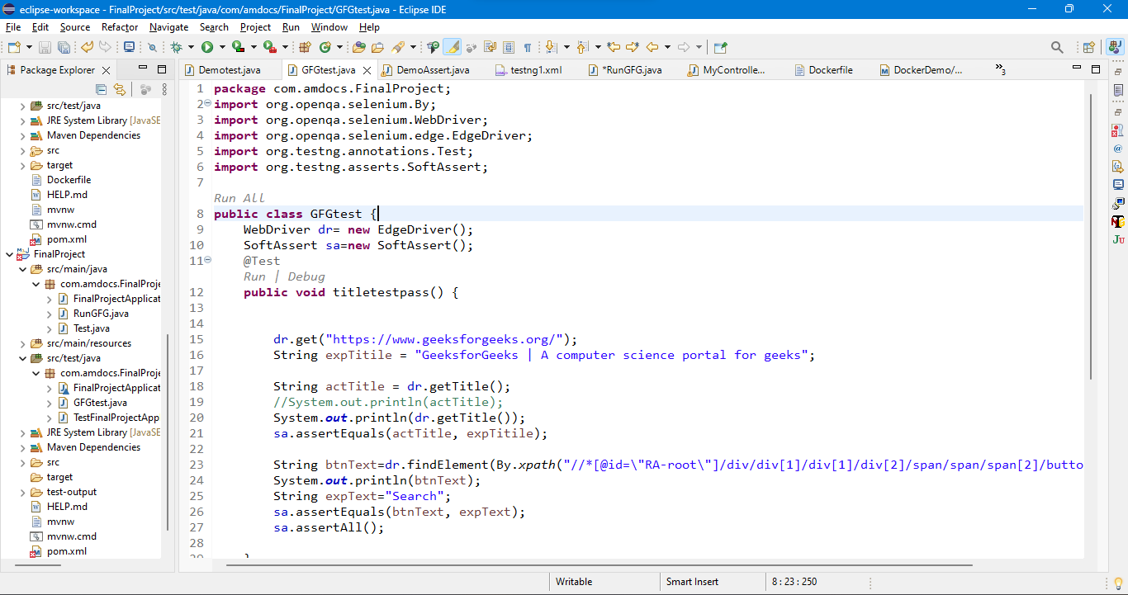
Selenium code screenshots

Slide 8
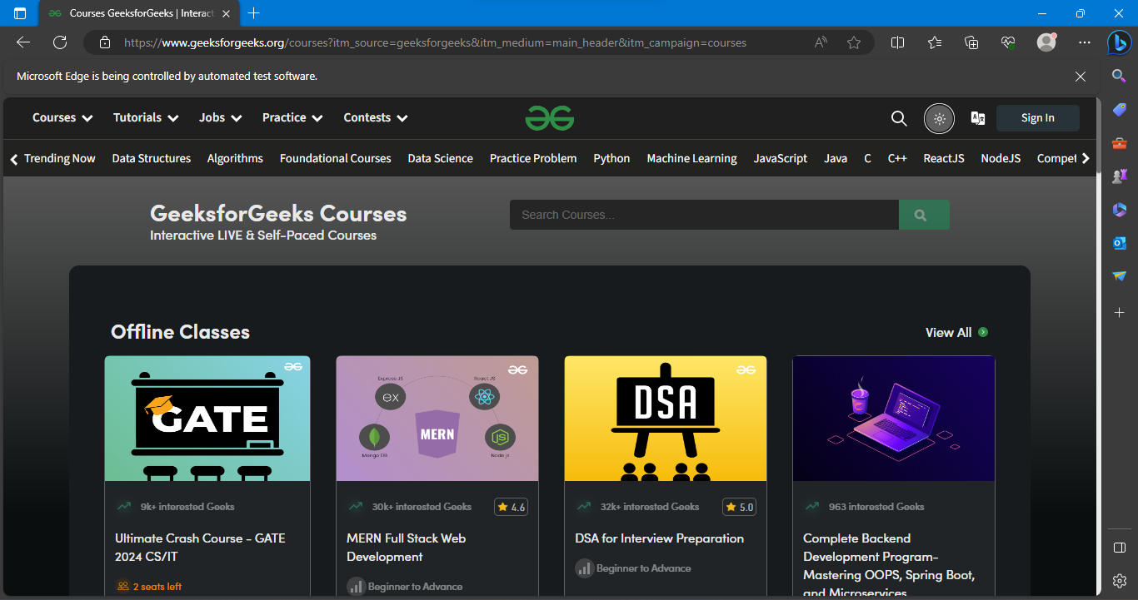
Selenium output screenshots

Slide 9
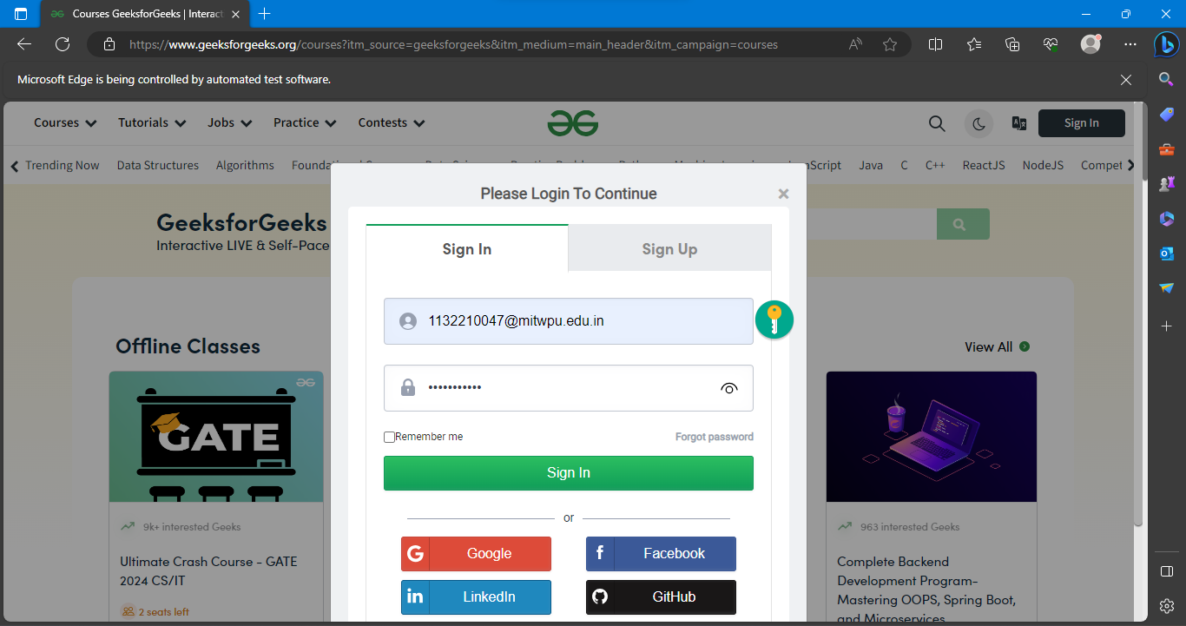
Selenium output screenshots

Slide 10
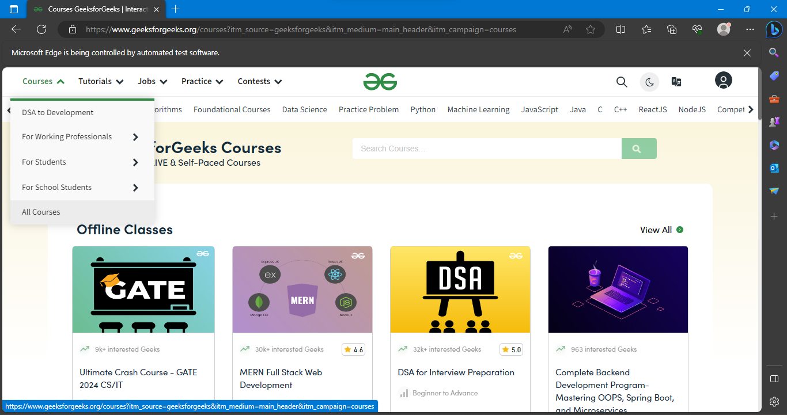
Selenium output screenshots

Slide 11
My work in Docker Project
Firstly I created a spring boot project in Java
Then I created a simple controller which returned a string with URL mapping .
After a successful run of the the spring boot project I created its image in docker through cmd prompt.
Finally we created its container and then pushed it on Docker hub .

Slide 12
Docker commands used
docker --version
docker pull mysql
docker images
docker ps
docker build -t [jar filename]:[version name] .
docker run -p 8084:8084 dockerdemo
Tag name:-docker tag dockerdemo:firstimage ameypach/dockerdemo
To push:- docker push tagname (ameypach/dockerdemo)

Slide 13
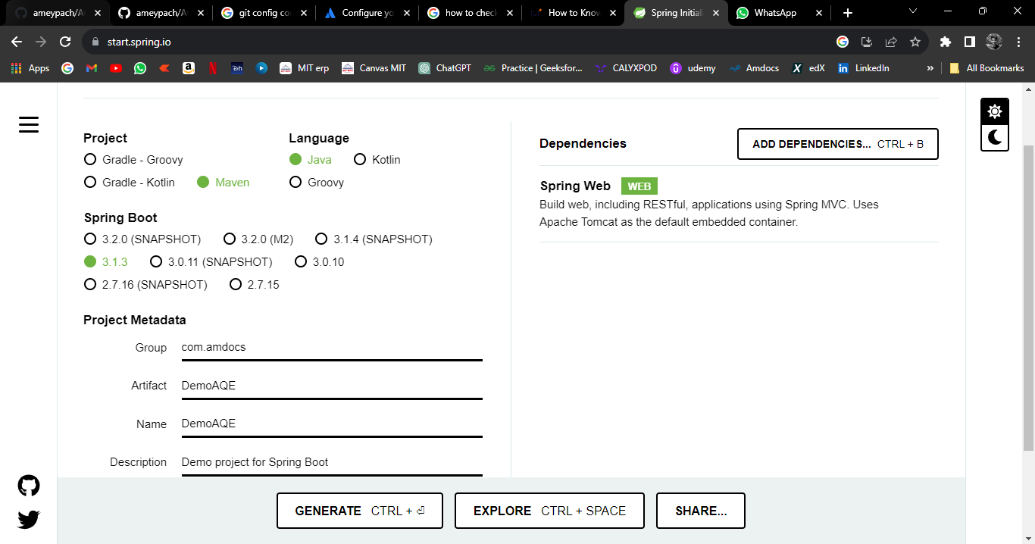
Docker Code Screenshots

Slide 14
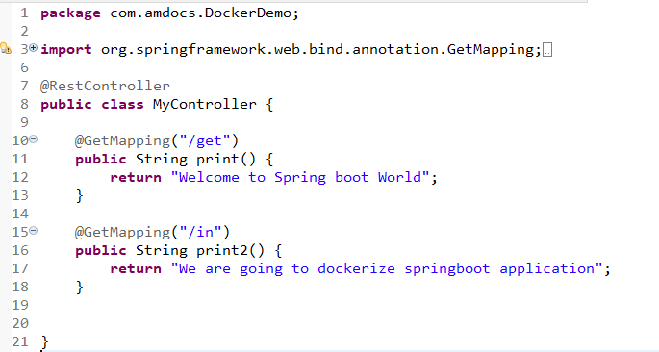
Docker Code Screenshots

Slide 15
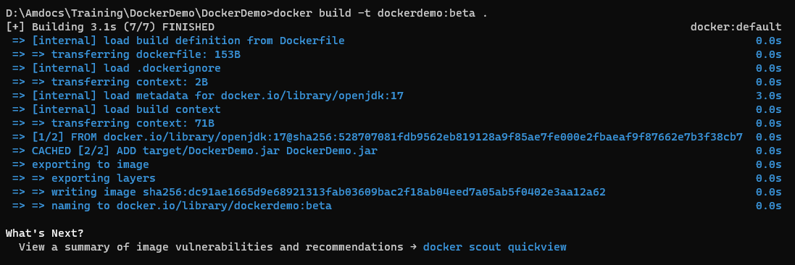
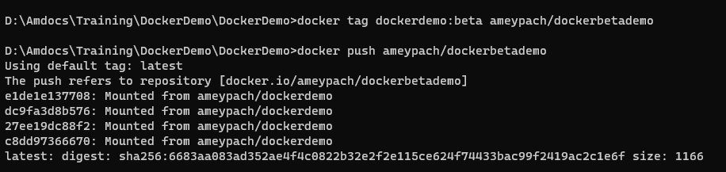
Docker Code Screenshots

Slide 16
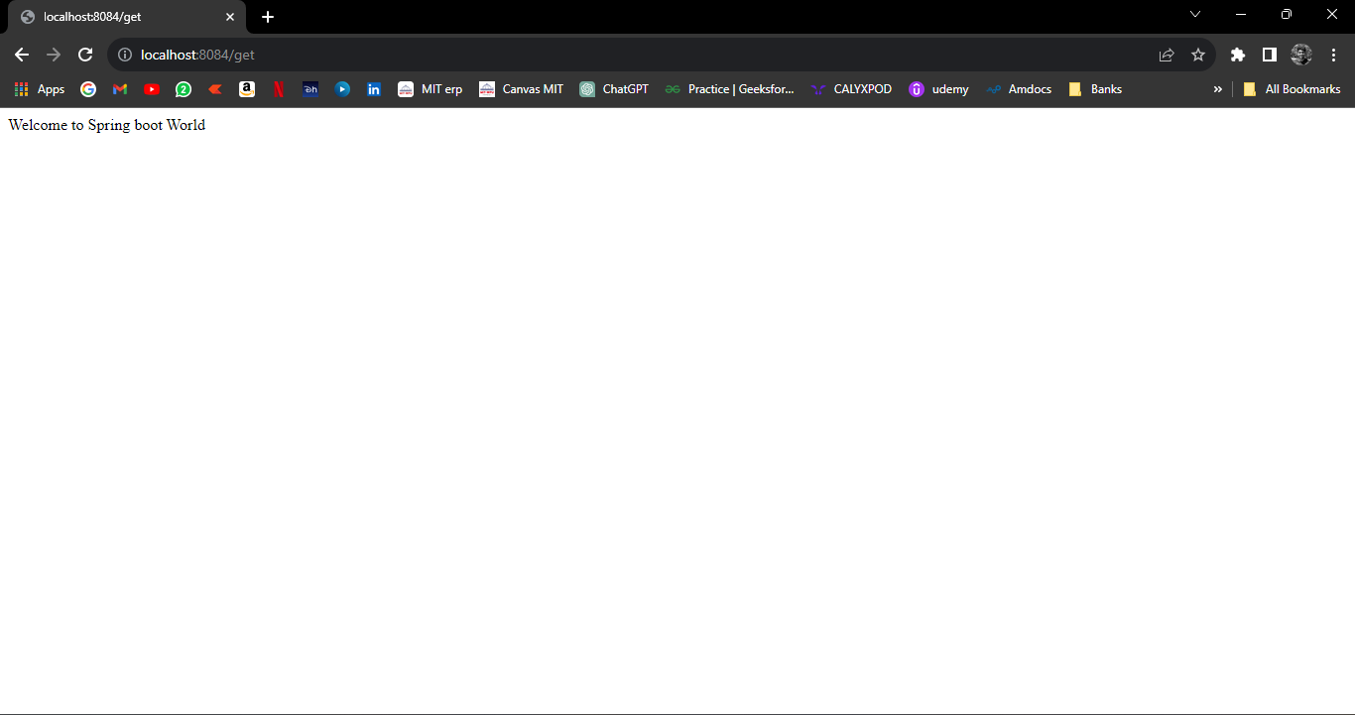
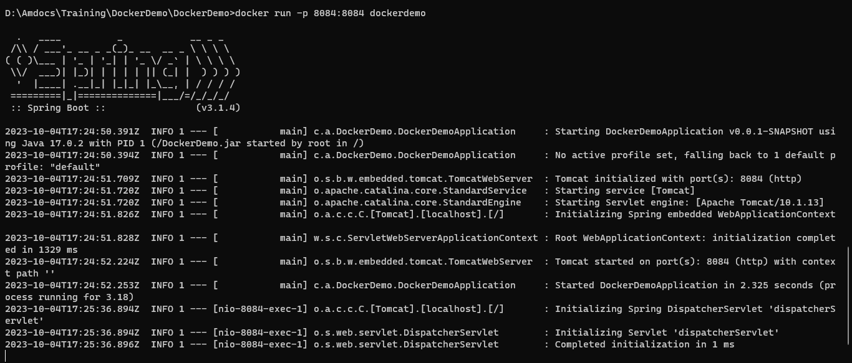
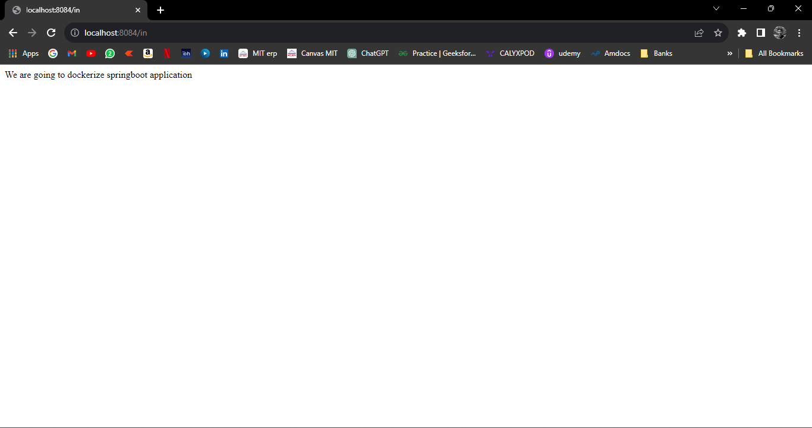
Docker Output Screenshots

Slide 17
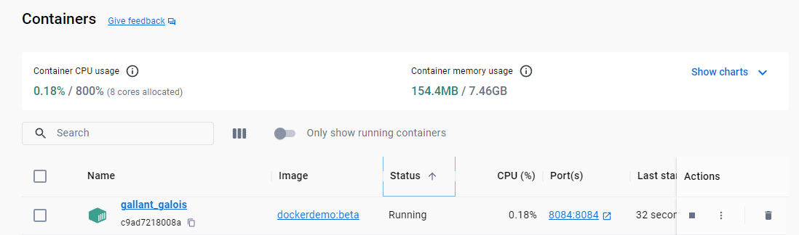
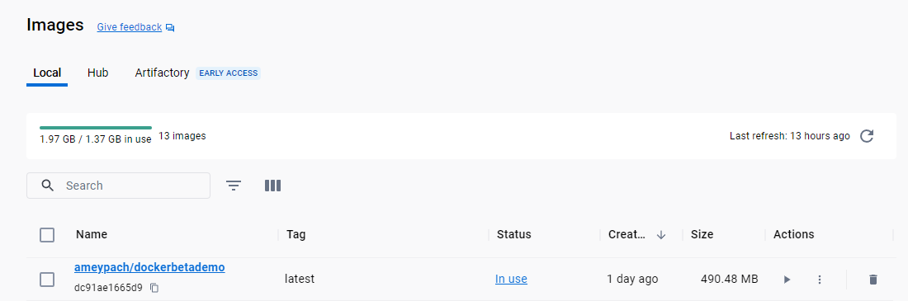
Docker Output Screenshots

Slide 18
Thank you!

